Slide 1
China's cheap Xiaomis are low on privacy
github: huuck twitter: @hookgab

Slide 2
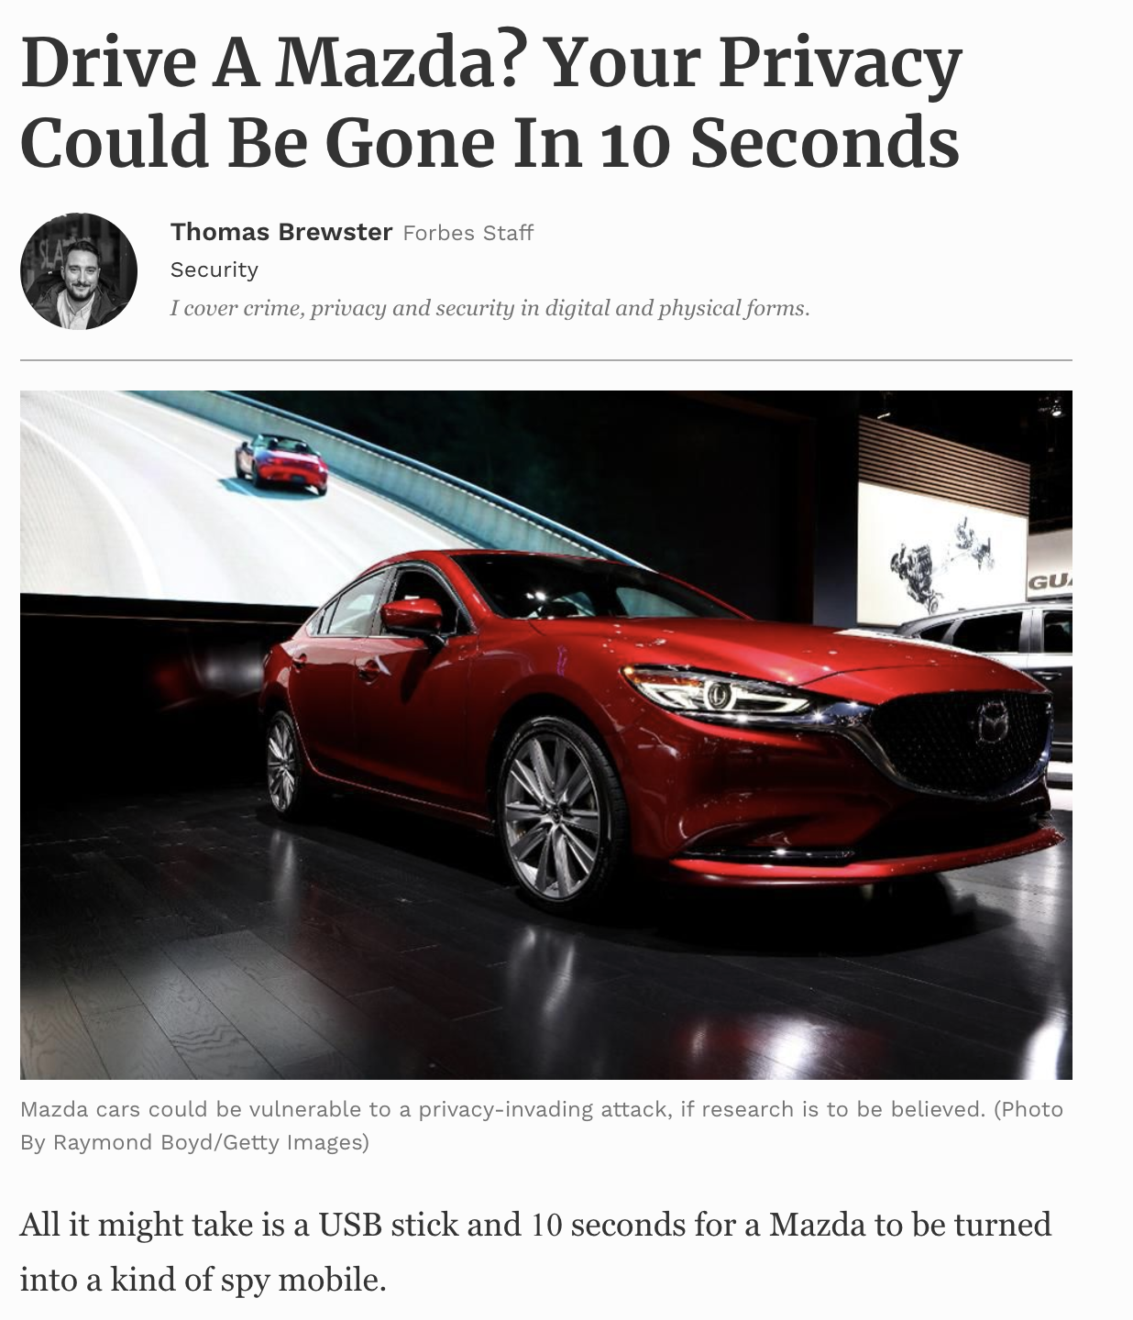

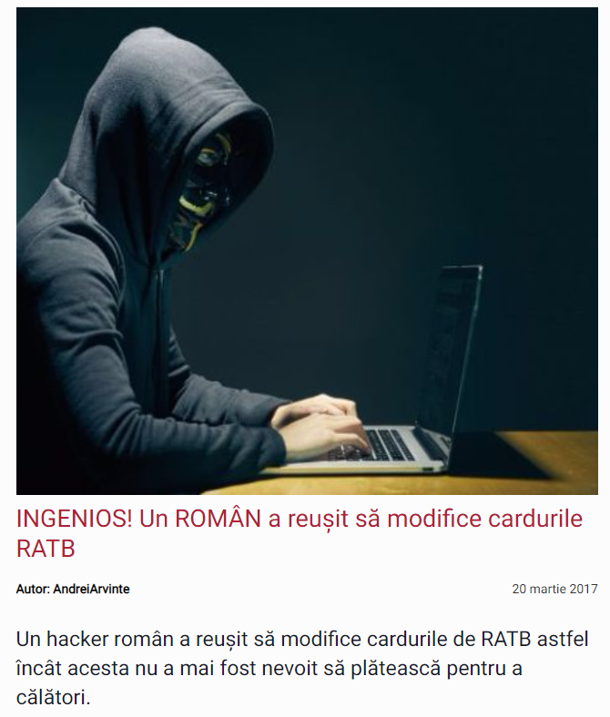
whoami
INGENIOUS! A ROMANIAN managed
to modify public transportation cards!

Slide 3
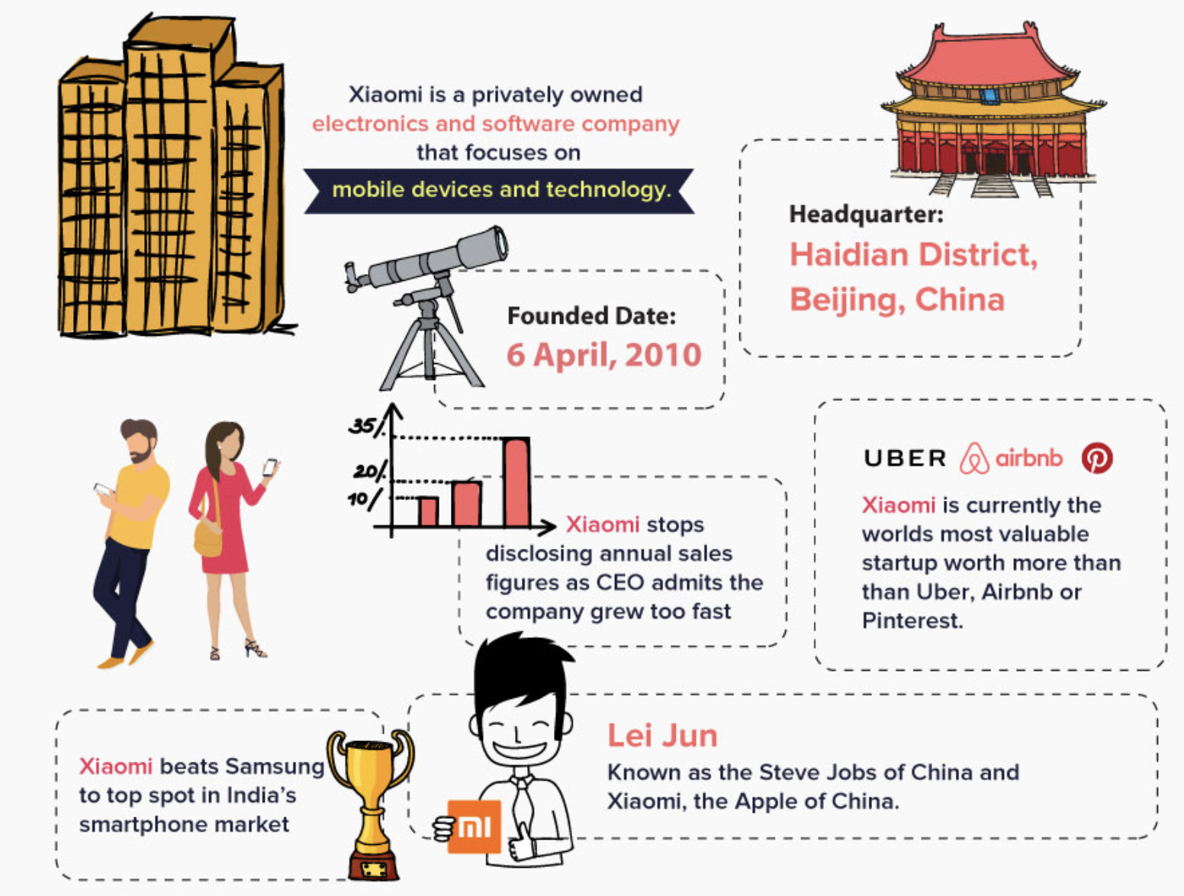
./who

Slide 4
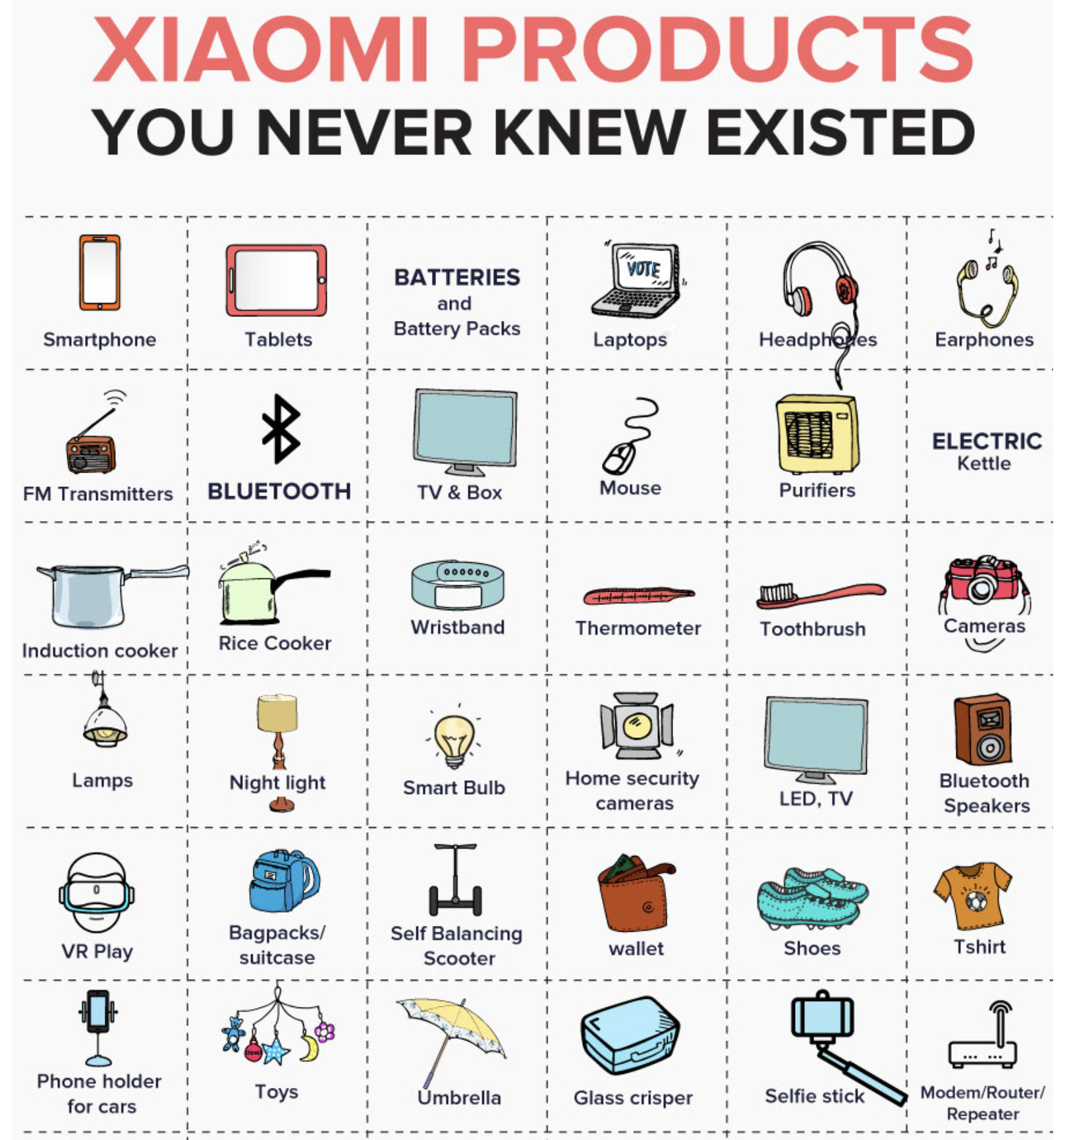
./who

Slide 5
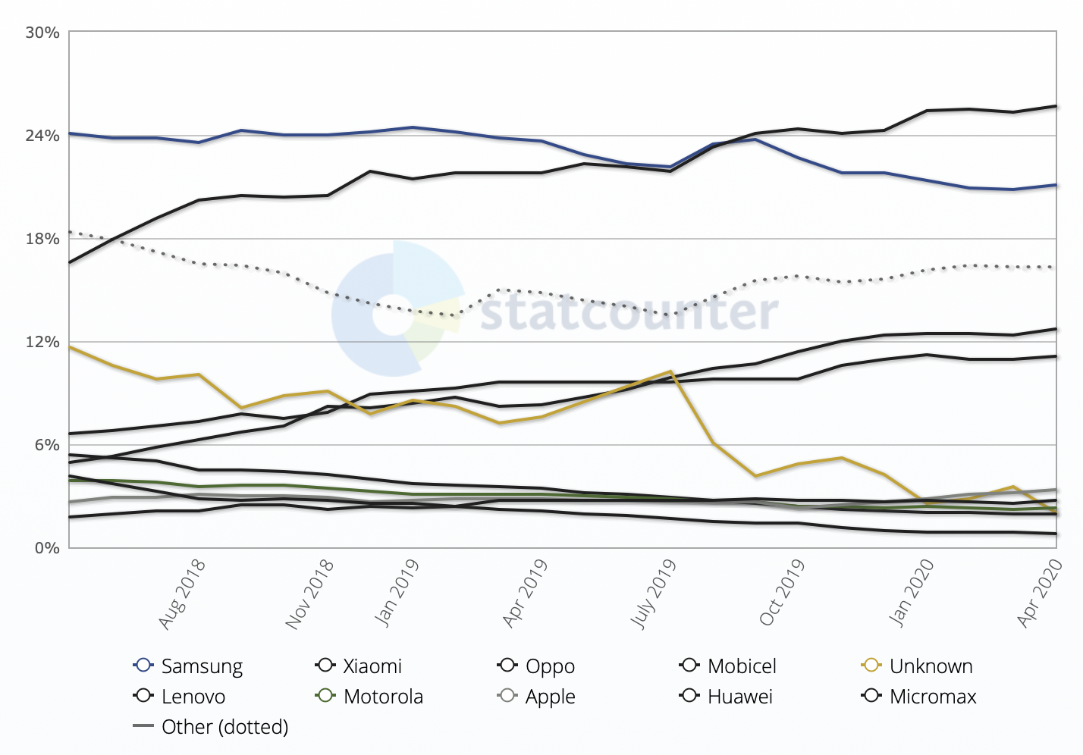
./who

Slide 6
./why
cheap
powerful
decent camera
NFC
solid display
???
what's the catch?

Slide 7
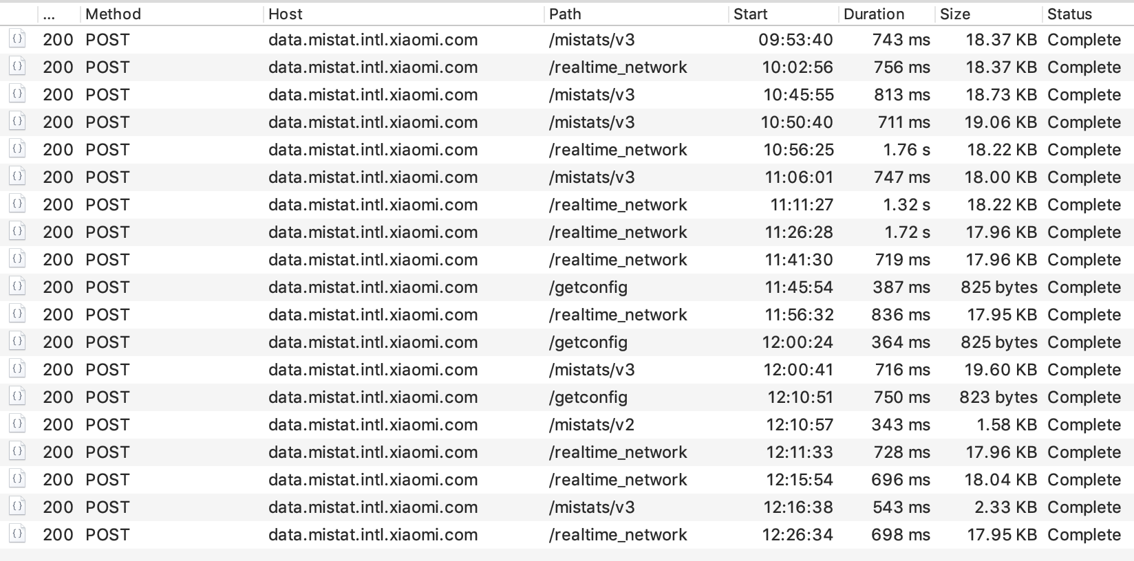
./how
brand new phone
rooted + custom cert
...
oh my that's a load of data

Slide 9


Slide 10

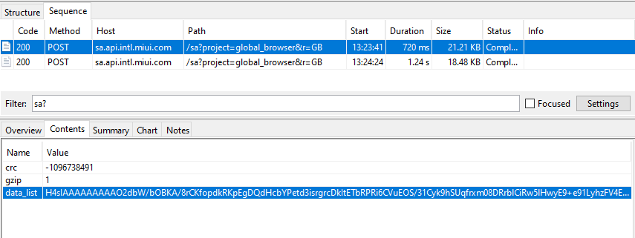
./how

Slide 11
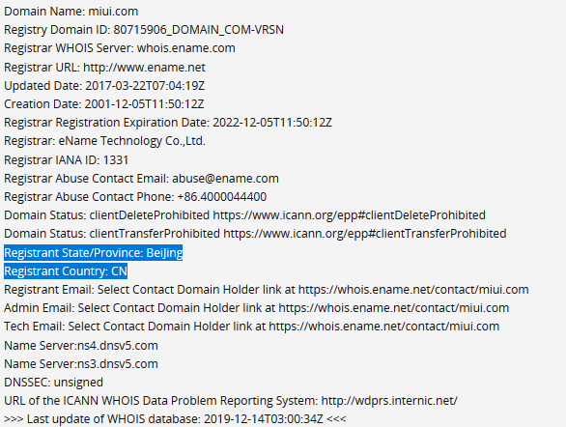
./how

Slide 12
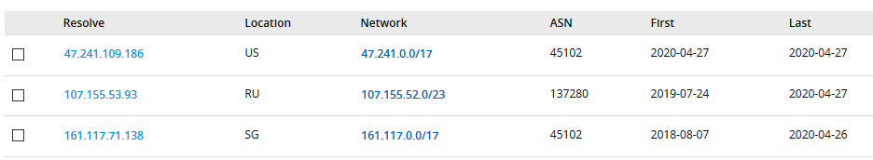
./how

Slide 13
./recap.sh
new phone
no apps
24 calls in 3 hours
chinese infrastructure
wat.jpg

Slide 14
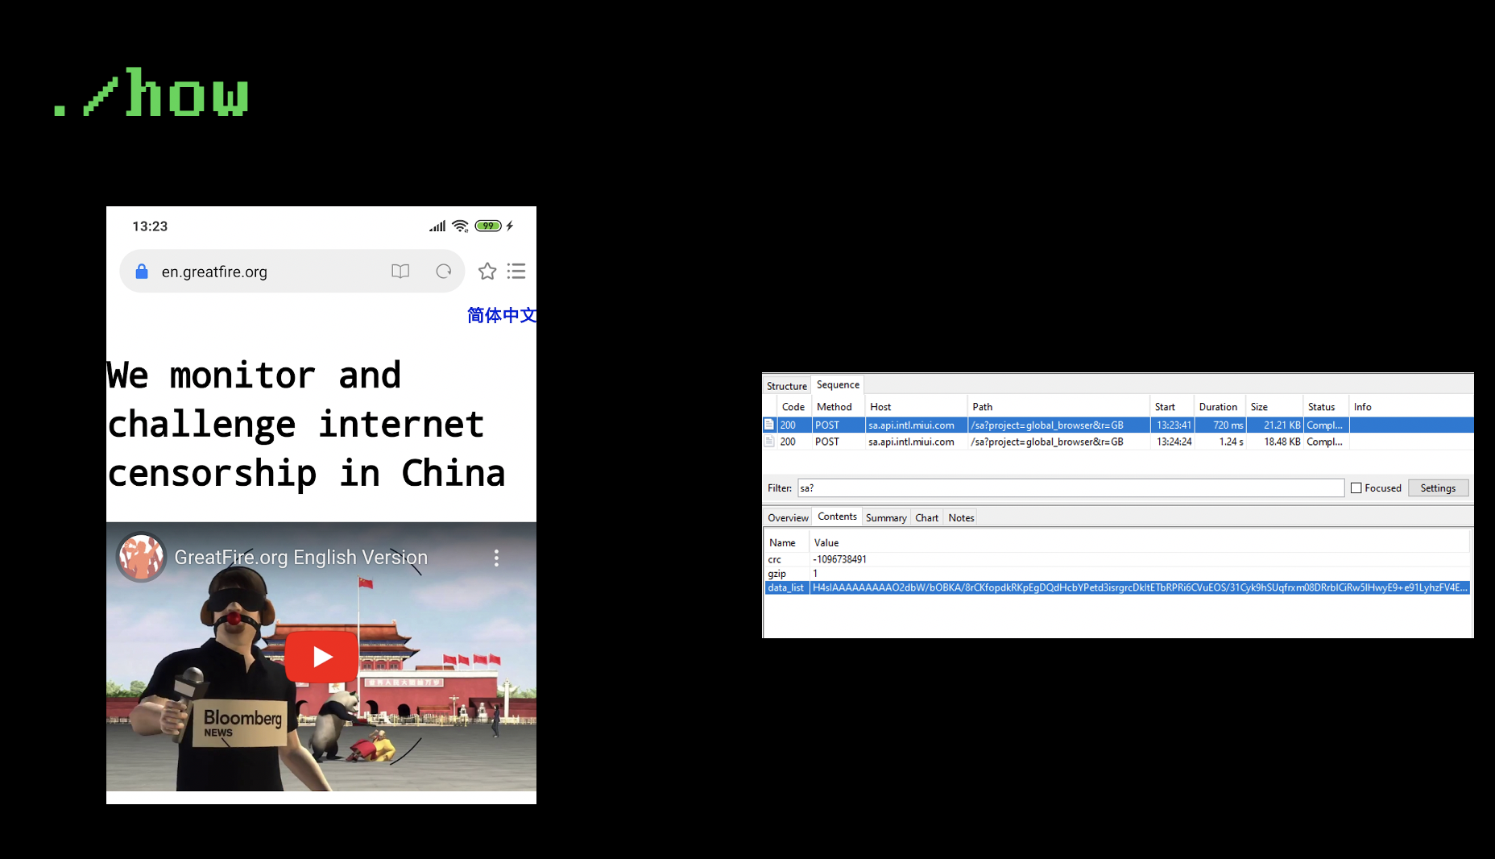
./what
slideception.jpg

Slide 15
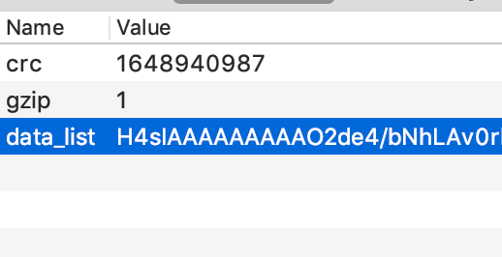
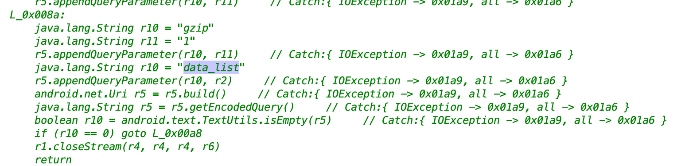
./how
sendHTTPRequest()

Slide 16
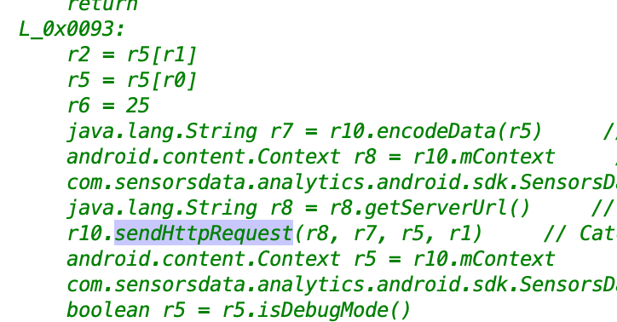
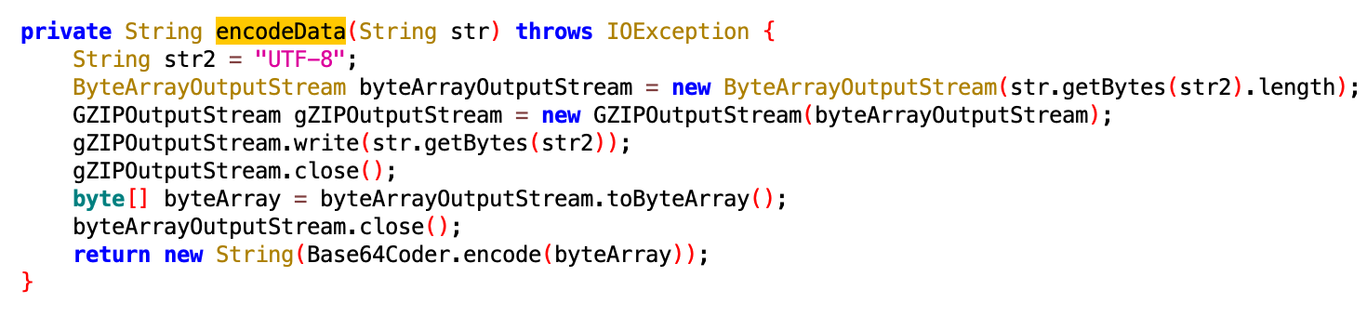
./how

Slide 17
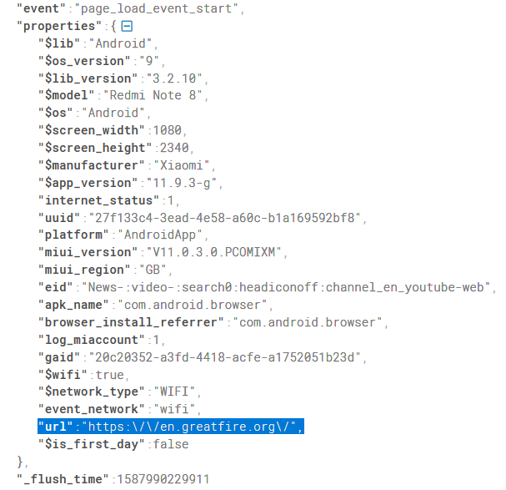
./what
visited URL
network type
device info
UUID (more later)
but wait, there's more

Slide 18
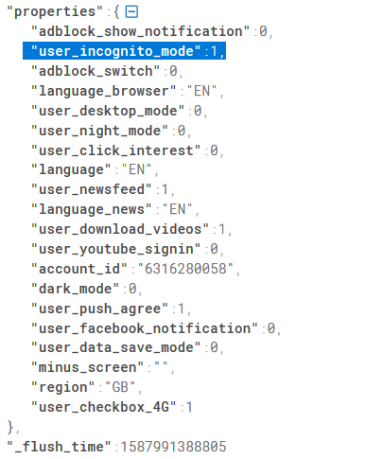
./what
MIUI id!!!
...
INCOGNITO MODE

Slide 19
./what
MIUI id
UUID ('member it?)
you cannot create a MIUI id without your phone number/email/social media account

Slide 20
./recap.sh
visited URLs
browsing history
search engine history
browsing behaviour
all can be correlated to your real persona
happens even in incognito mode

Slide 21
but wait, there's more

Slide 22
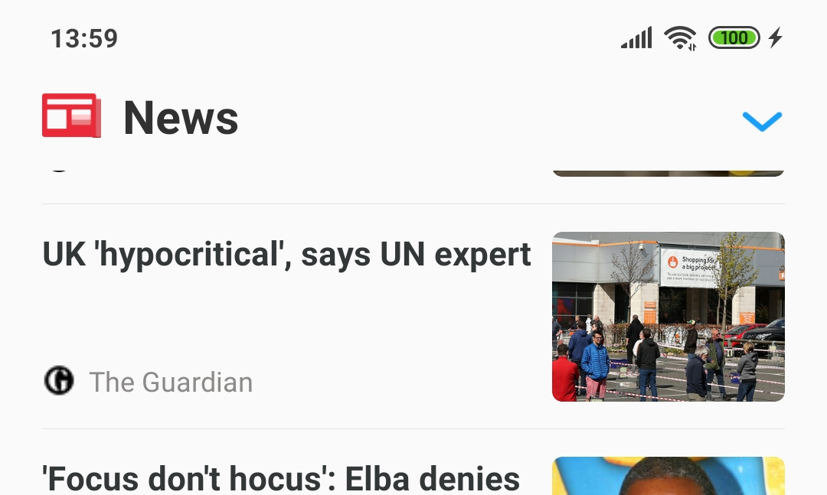
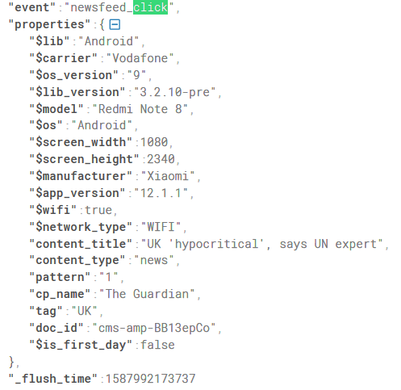
./what

Slide 23
./what

Slide 24
./what

Slide 25
./recap.sh
what news you watch
what music you play OFFLINE
what are your home screen folders named

Slide 26

./what
download firmware
brotli extractor
sdat2img
pull APKs/VDEX from system.img
???
prophit

Slide 27
./aftermath

Slide 28
./what

Slide 29
./what
spyware

Slide 30
./what

Slide 31
./what

Slide 32

echo good_news.txt

Slide 33
THANK YOU!
github: huuck twitter: @hookgab

